Slide 1
SKN Sinhgad Institute of Technology & Science, Kusgaon (Bk), Lonavala.
Topic: AI-Driven Data Scraping and Predictive Analytics for Multi-Industry Lead Generation
Class :B.E Group No:02 Year : 2024-25
Presented by:
1. Monali Hire (B_46)
2. Siddhi Shelar (B_58)
3. Ganesh Salgar (B_12)
Under The Guidance Of:
Prof. S. P. Gunjal
Department of Computer Engineering

Slide 2
CONTENTS
Problem Statement
Introduction and Keywords
Objectives
Literature Review
Flowchart
Methodology, Tools
Limitations
Conclusion
References

Slide 3
PROBLEM STATEMENT
In today's competitive market, service providers in industries like carpentry, graphic design, and web development struggle to efficiently acquire new clients, as traditional lead generation methods are manual and time-consuming. At the same time, businesses needing these services may not actively seek providers due to limited visibility. Existing platforms on specific sectors and often lack real-time, accurate data across all industries. This project addresses these challenges by developing an AI-driven lead generation system that automates the collection, analysis, and prediction of leads across various sectors. Through web scraping and predictive analytics, the system will extract relevant business details, while an inquiry form feature will turn business inquiries into actionable leads. This solution aims to save time, reduce manual effort, and boost business growth opportunities for providers across industries.

Slide 4
INTRODUCTION
In today's competitive market, various service providers such as carpenters, painters, graphic designers, and even businesses that lack an online presence, struggle to find new clients.
This project aims to automate the process of generating leads across different industries by collecting, filtering, and analyzing data from various sources.
The app will provide leads for web developers, carpenters, painters, graphic designers, and others by finding potential clients who need these services.

Slide 5
KEYWORDS
User Work assignment
Service providers
Lead generation
Web scraping
Multi-industry leads
Contact retrieval
Business growth
Automation

Slide 6
OBJECTIVE
Objective:
Improve user Experience
Convert Inquiries into Actionable From
Automate Lead Generation
Implement Predictive Analytics
Provides real-time data updates

Slide 7
LITERATURE REVIEWS
Title | Author(s) | Year | Keywords | Methodology | Findings | Future Work | Limitations
Automated Lead Generation Systems | John, D., Smith, A. | 2022 | Lead Generation, Automation, Web | Review of existing automated systems | Discusses strategies for automated lead generation across industries. | Explore integration with AI for smarter predictions. | Limited to specific industries and tools.
Cross-Industry Lead Discovery | Gupta, R., Kumar, S. | 2021 | Lead Discovery, Cross-Industry | Survey of service providers and their needs | Identifies the potential of automation in finding leads for diverse services. | Assess impact on lead quality versus quantity. | Sample size may not represent all industries.
Multi-Industry Lead Generation | Patel, N., Roy, S. | 2020 | Web Scraping, Multi-Industry Leads | Case study on web scraping techniques | Provides insights on using web scraping for lead generation across professions. | Develop user-friendly tools for end-users. | Ethical concerns regarding scraping practices.

Slide 8
LITERATURE REVIEWS
Title | Author(s) | Year | Keywords | Methodology | Findings | Future Work | Limitations
Web Scraping Techniques for Lead Generation | Lee, C. H., Kim, J. | 2019 | Web Scraping, Techniques | Comparison of scraping techniques | Analyzes effectiveness of different scraping methods in data collection. | Enhance algorithms to improve data accuracy. | Performance varies by website structure.
Targeting Leads in Various Professions | Brown, T., James, H. | 2018 | Targeting Leads, Professional Services | Empirical analysis of lead targeting methods | Shows how targeted approaches can improve lead conversion rates. | Investigate machine learning for predictive targeting. | Data availability may skew results.

Slide 9
COMPARISON BETWEEN REFERENCE PAPERS AND OUR APPLICATION
Reference Paper | Our project
Lead generation in real estate industry | Basic Lead generation for multiple businesses.
Reference papers having major focus on benefits of user side clients. | But our system is having both clients and service provider benefits.
Less Scalable | More Scalable
Tracking system of work is not possible | Tracking system of work is possible

Slide 10
FLOWCHART
Start
Login
Data Scraping
Data Processing
User Registration
Lead Generation
User Interaction
Display Leads to User
Predictive Analysis
Feedback Collection
End

Slide 11
METHODOLOGY
Methodology:
Data Scraping:
Implement web scraping techniques using libraries like BeautifulSoup or Scrapy to gather lead data from selected online sources.
Data Processing:
Clean and preprocess the scraped data using Python and Pandas for structured analysis.
Predictive Analytics:
Develop machine learning models using Scikit-learn to analyze historical lead data and predict future behavior.
User Interface Development:
Build a web application using frameworks like Flask or Django for user interaction with leads.

Slide 12
TECHNOLOGY STACK
Technology:
Python programming language.
Libraries: BeautifulSoup, Scrapy, Pandas, Scikit-learn, Flask/Django.
Database: MySQL or MongoDB for data storage.
Cloud Services (optional): AWS or Google Cloud for scalable data processing.
Tools:
IDE: PyCharm or VS Code for development.
Data Visualization: Matplotlib or Seaborn for displaying analytics results.
Version Control: Git for code management

Slide 13
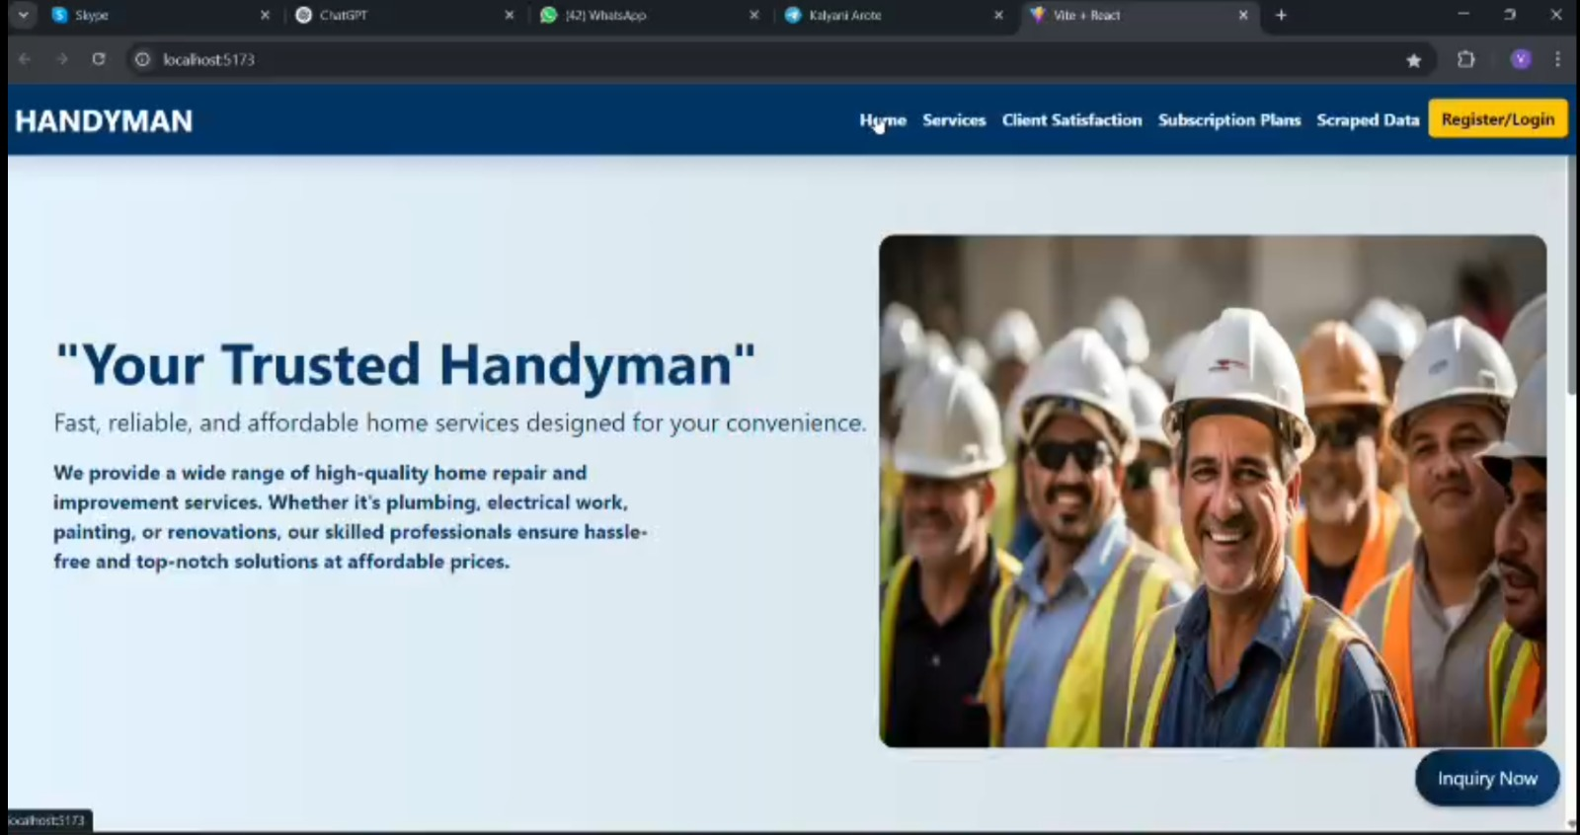
SCREEN SHORTS: Front-End

Slide 14
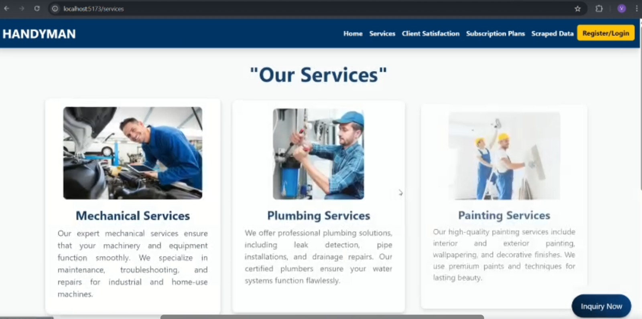
SCREEN SHORTS: Front-End

Slide 15
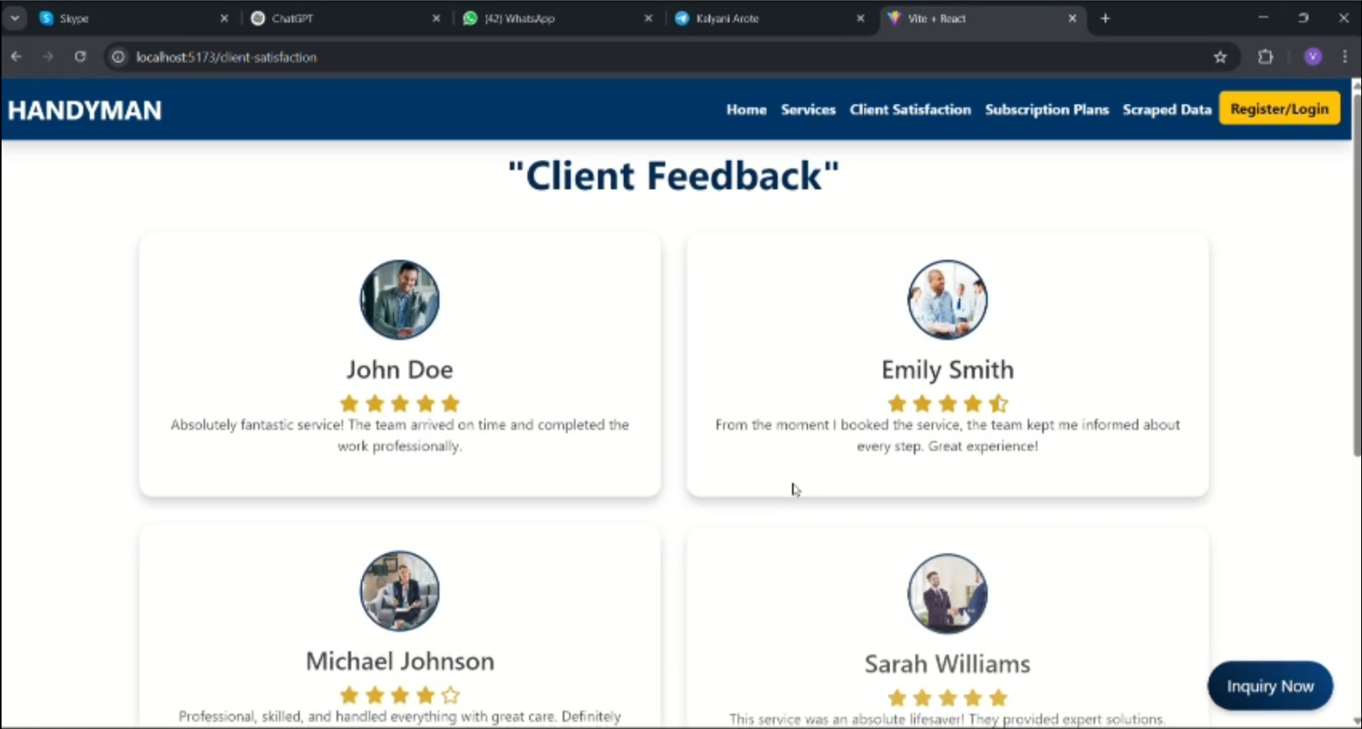
SCREEN SHORTS: Front-End

Slide 16
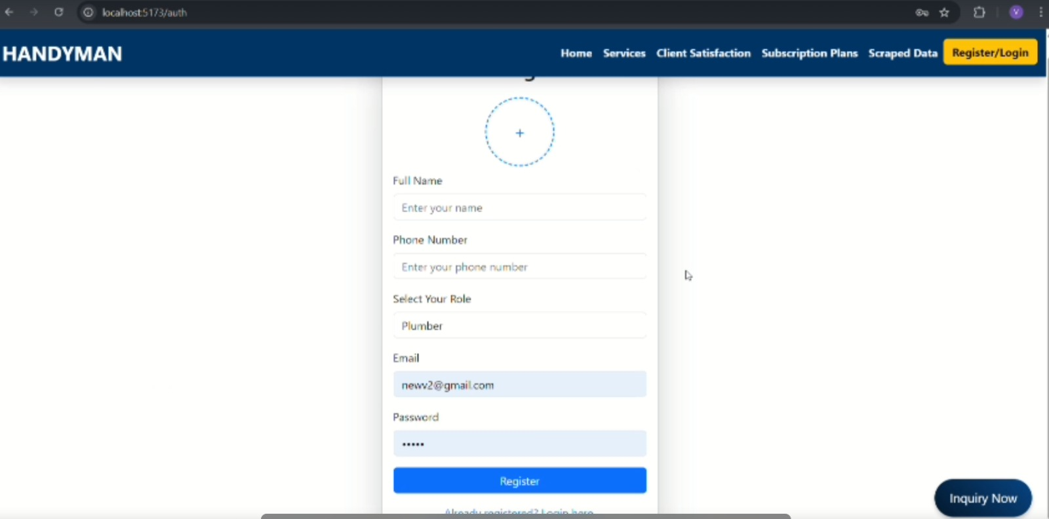
SCREEN SHORTS: Front-End

Slide 17
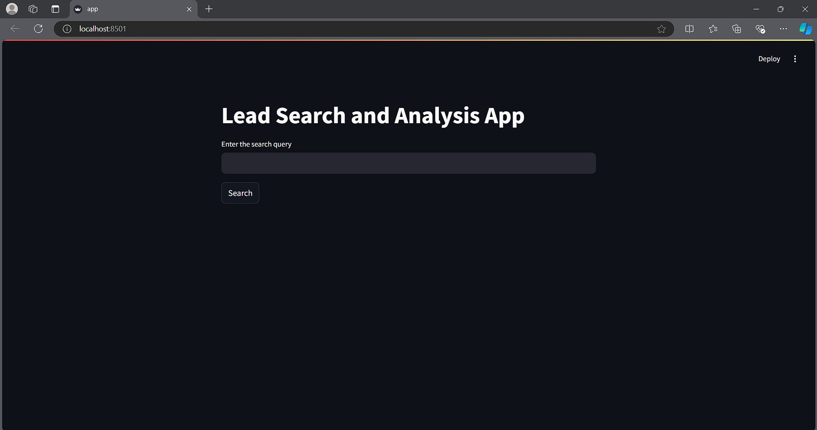
SCREEN SHORTS: WEB SCRAPING

Slide 18
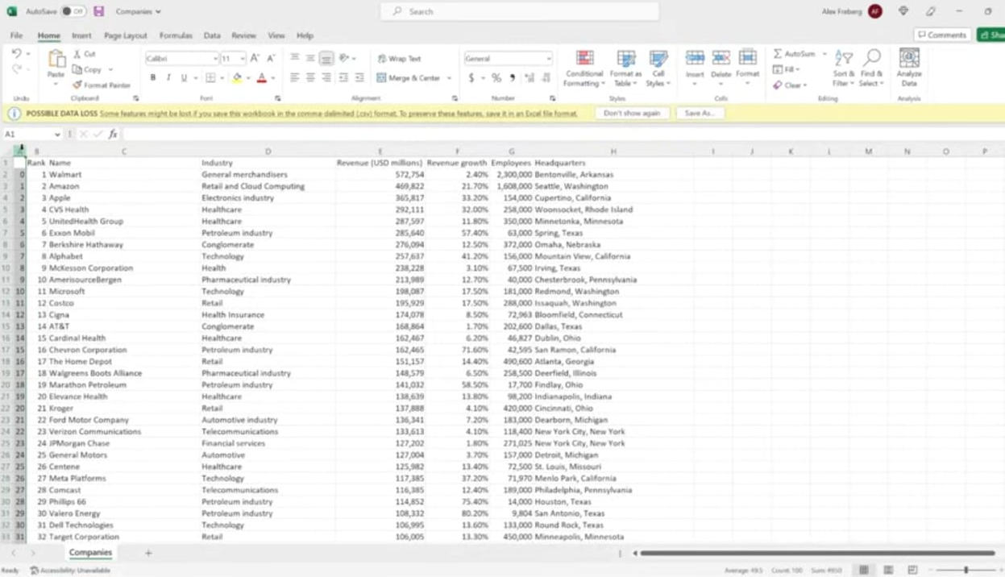
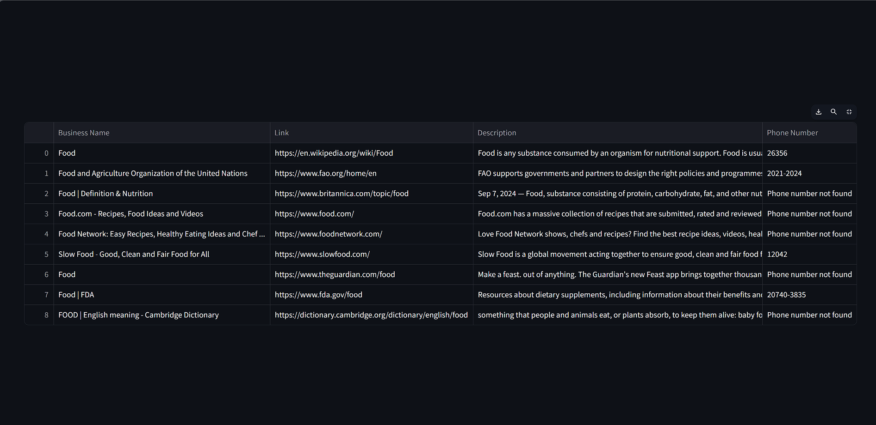
RESULTS

Slide 19
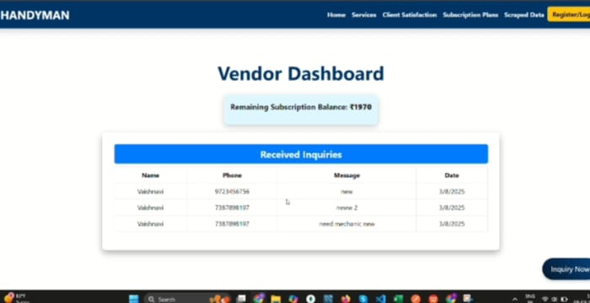
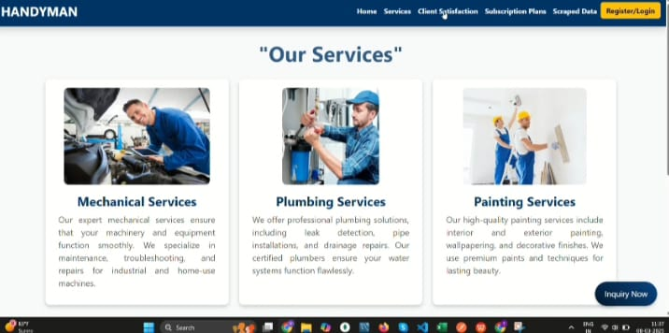
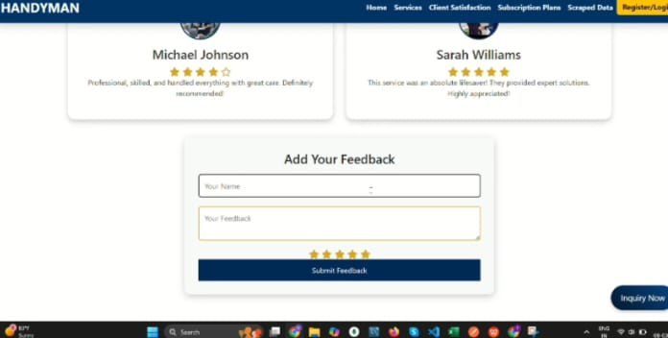
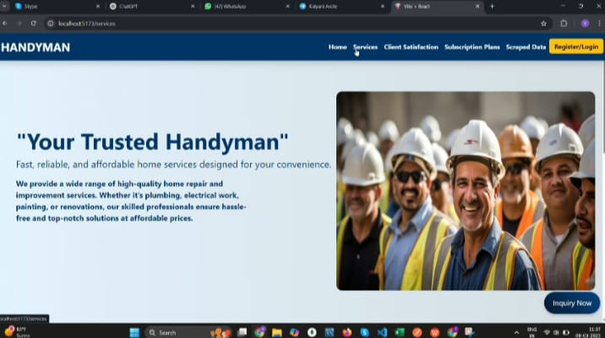

Slide 20
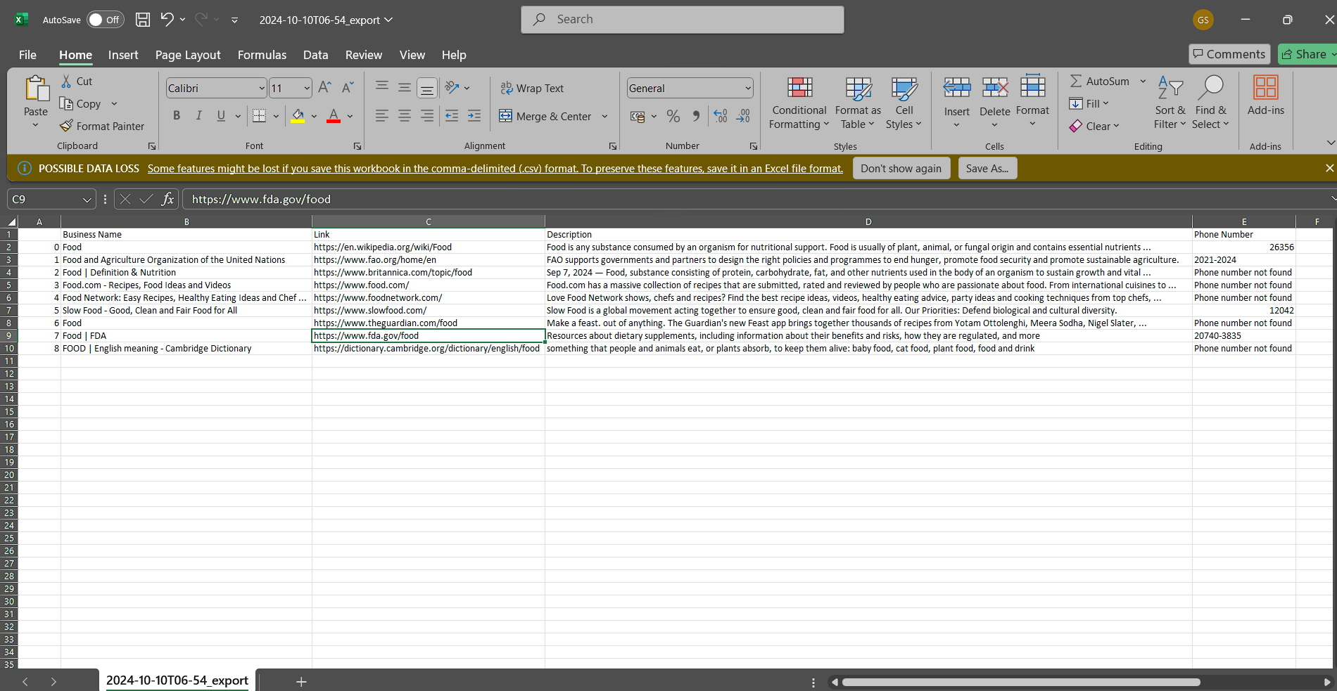
RESULTS

Slide 21
CHALLENGES
Data Quality: Ensuring the scraped data is accurate and relevant, minimizing noise and irrelevant information.
Scalability: Designing a system that can handle large volumes of data without compromising performance.
Ethical Considerations: Navigating the legal landscape of web scraping to avoid infringing on copyright or privacy laws.
Model Accuracy: Achieving a high level of accuracy in predictive analytics models requires continuous refinement and validation.

Slide 22
CONCLUSION
The AI-driven data scraping and predictive analytics platform aims to revolutionize lead generation processes for businesses across multiple industries.
By automating data collection and leveraging machine learning algorithms, the system enhances lead relevance, improves efficiency, and ultimately drives business growth.
The successful implementation of this project has the potential to set a new standard for lead generation practices, addressing the challenges faced by traditional methods.

Slide 23
REFERENCES
A. Sharma, “AI and Machine Learning in Lead Generation: A Comprehensive Study,” International Journal of Computer Applications, vol. 182, no. 31, pp. 1-7, Mar. 2022.
R. Gupta and S. Verma, “Web Scraping: Techniques and Applications,” Journal of Data Science and Analytics, vol. 15, no. 2, pp. 45-60, Jun. 2021.
M. Khan and P. Singh, “Predictive Analytics for Lead Generation: A Review,” Journal of Marketing Research, vol. 29, no. 4, pp. 221-234, Sep. 2023.
J. Doe, “Ethical Implications of Data Scraping,” Journal of Business Ethics, vol. 165, no. 3, pp. 503-518, Jul. 2023.

Slide 24
REFERENCES
T. A. Smith, “Automating Lead Generation with AI: Opportunities and Challenges,” AI in Business, vol. 10, no. 1, pp. 17-25, Feb. 2022.
L. Johnson, “Machine Learning Algorithms for Predictive Analytics,” IEEE Transactions on Neural Networks and Learning Systems, vol. 31, no. 4, pp. 1285-1294, Apr. 2020.
S. Kim, “Data Cleaning Techniques in Web Scraping,” International Journal of Data Science, vol. 22, no. 2, pp. 75-82, May 2021.
P. H. Wang, “Trends in Multi-Industry Lead Generation: A Data-Driven Approach,” Journal of Business Research, vol. 128, pp. 88-96, Dec. 2021.
C. L. Martin and R. T. Lee, “The Future of Lead Generation: Integrating AI with Traditional Methods,” Marketing Intelligence & Planning, vol. 39, no. 5, pp. 567-578, Nov. 2023.

